Slide 1
PLANT SPECIES IDENTIFICATION
Submitted in the partial fulfillment for the award of the degree of
BACHELOR OF ENGINEERING
IN
COMPUTER SCIENCE WITH SPECIALIZATION IN AI & ML AND BIG DATA ANALYSIS
Submitted by:
ANKIT GHOSAL
20BCS6621
LALIT BISHT
20BCS6609
KAKKIRALA LOHITH KUMAR
20BCS3880
Under the Supervision of:
Ms. MERRY
DISCOVER . LEARN . EMPOWER
Department of AIT-CSE

Slide 2
Outline
Introduction to Project
Problem Formulation
Objectives of the work
Methodology used
Results and Outputs
Conclusion
Future Scope
References

Slide 3
Introduction to Project
Plants are essential to the balance of nature and in people's lives. They are the ultimate source of food and metabolic energy for nearly all animals, which cannot manufacture their own food. Thus the study of plants is vital because they are a fundamental part of life on Earth, and generate the oxygen and food that allow humans and other organisms to exist.
All life on Earth depends on plants, which are also a vital resource for people's health. Botanists can utilise this application for therapeutic purposes, but plant recognition is crucial for managing plant species in agriculture.
By using a computer-aided plant identification system also non-professionals can take part in this process. Therefore, it is not surprising that large numbers of research studies are devoted to automate the plant species identification process.
This study uses machine vision and digital image processing to propose a straightforward and computationally effective approach for identifying plants.

Slide 4
Problem Formulation
Both the harmony of nature and the life of humans depend on plants. Nearly all animals, who are unable to produce their own food, rely on them as their primary source of nutrition and metabolic energy. In light of the fact that plants are an essential component of life on Earth and provide humans with food and oxygen, it is important to study them.as well as other living things. Botanists' work can be automated by using a digital plant identification system to quickly characterize plant species without their knowledge.
This paper explains our method for identifying plants from digital photographs of their leaves. Due to the seasonality of fruits and flowers and the disparity in root and stem characteristics, leaf-based traits are chosen above fruits, flowers, roots, and other aspects. There are various freely accessible leaf picture databases, including the ImageCLEF dataset, Leafsnap dataset, Intelligence dataset, and Flavia dataset. Using the Flavia dataset, the experiment's performance is assessed

Slide 5
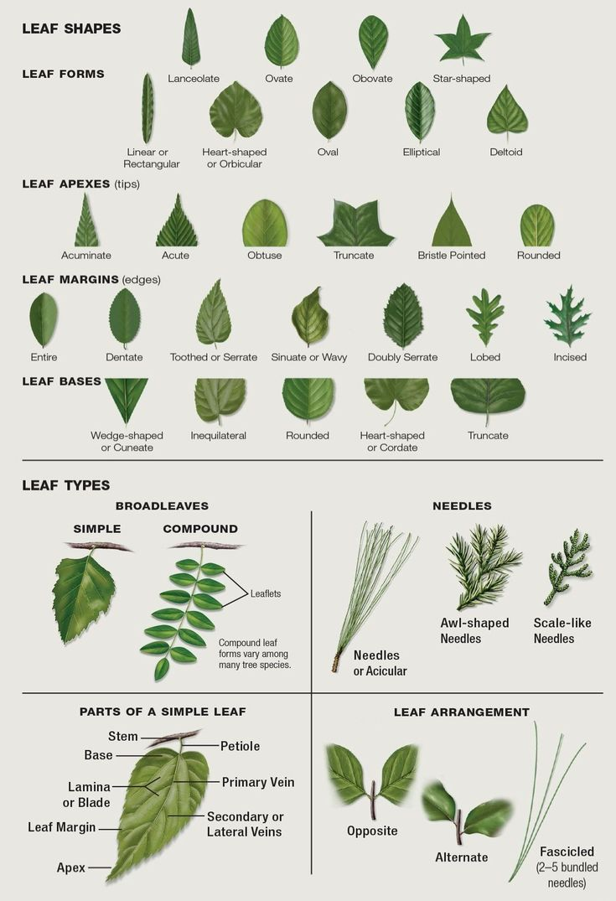
Objectives of the Work
Using machine learning algorithm to correctly identify plant species through the binary leaf images and evaluated features.
Implementing the process of identification using different algorithms to get the best result and to identify the best process of identification.
Making a product to ease the life of gardeners, forest officials and anyone who has a curiosity regarding the environment around them.

Slide 6
Methodology used
The following will be followed to achieve the objectives defined for proposed work:
Collection of good quality images of leaves
Preparing the dataset of plant species
Installing the required the set of libraries
Giving the image of leaf for identifying the plant species
Applying machine learning model to predict the species

Slide 7
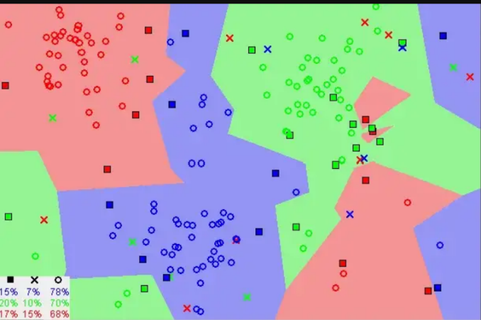
K-NEAREST NEIGHBOUR
The k-nearest neighbors (KNN) algorithm is a simple, easy-to-implement supervised machine learning algorithm that can be used to solve both classification and regression problems.
Notice in the image above that most of the time, similar data points are close to each other. The KNN algorithm hinges on this assumption being true enough for the algorithm to be useful. KNN captures the idea of similarity (sometimes called distance, proximity, or closeness) with some mathematics we might have learned in our childhood— calculating the distance between points on a graph.

Slide 8
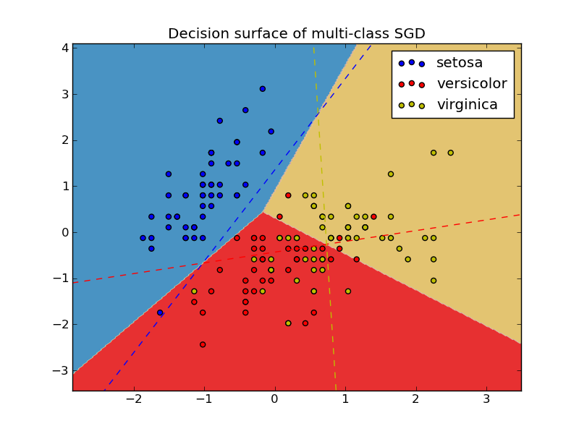
SGD CLASSIFIER
SGD Classifier is a linear classifier (SVM, logistic regression, a.o.) optimized by the SGD. These are two different concepts. While SGD is a optimization method, Logistic Regression or linear Support Vector Machine is a machine learning algorithm/model. You can think of that a machine learning model defines a loss function, and the optimization method minimizes/maximizes it.
Stochastic gradient descent (SGD) computes the gradient using a single sample.

Slide 9
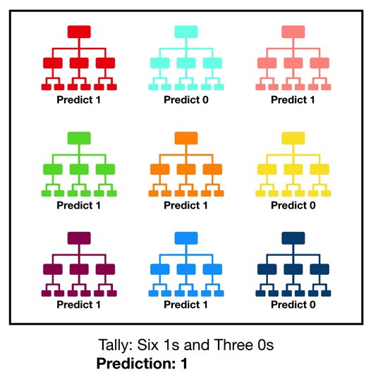
RANDOM FOREST CLASSIFIER
Random Forest is a popular machine learning algorithm that belongs to the supervised learning technique. It can be used for both Classification and Regression problems in ML. It is based on the concept of ensemble learning, which is a process of combining multiple classifiers to solve a complex problem and to improve the performance of the model.
"Random Forest is a classifier that contains a number of decision trees on various subsets of the given dataset and takes the average to improve the predictive accuracy of that dataset." Instead of relying on one decision tree, the random forest takes the prediction from each tree and based on the majority votes of predictions, and it predicts the final output.

Slide 10
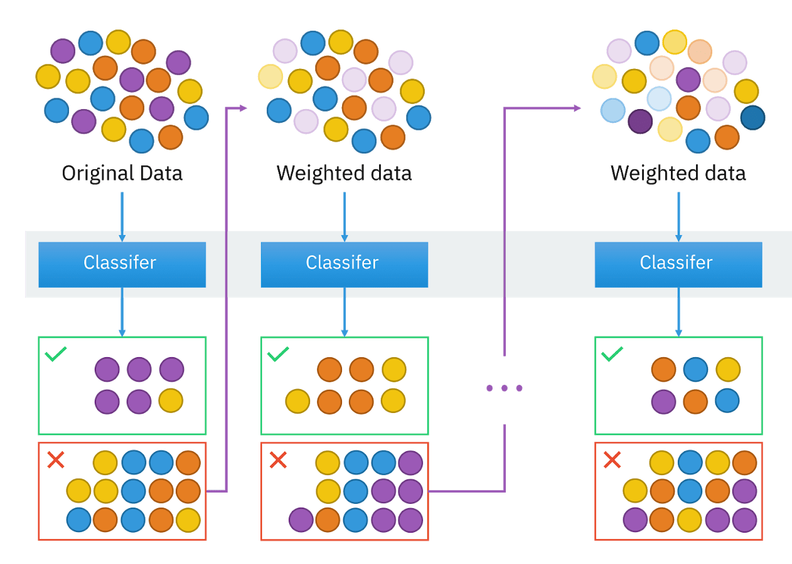
XGB CLASSIFIER
XGBoost is an implementation of Gradient Boosted decision trees.
XGBoost models majorly dominate in many Kaggle Competitions. In this algorithm, decision trees are created in sequential form. Weights play an important role in XGBoost. Weights are assigned to all the independent variables which are then fed into the decision tree which predicts results. The weight of variables predicted wrong by the tree is increased and these variables are then fed to the second decision tree. These individual classifiers/predictors then ensemble to give a strong and more precise model. It can work on regression, classification, ranking, and user-defined prediction problems.

Slide 11

SVM CLASSIFIER
“Support Vector Machine” (SVM) is a supervised machine learning algorithm that can be used for both classification or regression challenges. However, it is mostly used in classification problems. In the SVM algorithm, we plot each data item as a point in n-dimensional space (where n is a number of features you have) with the value of each feature being the value of a particular coordinate. Then, we perform classification by finding the hyper-plane that differentiates the two classes very well

Slide 12
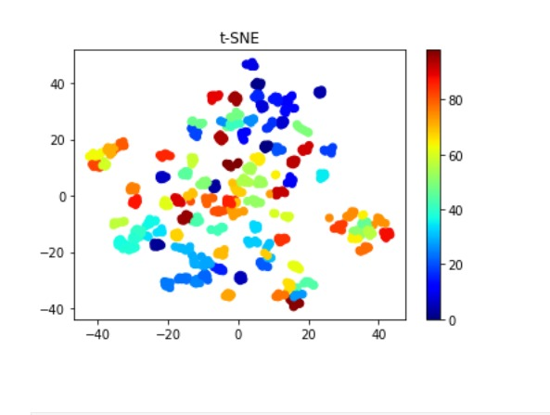
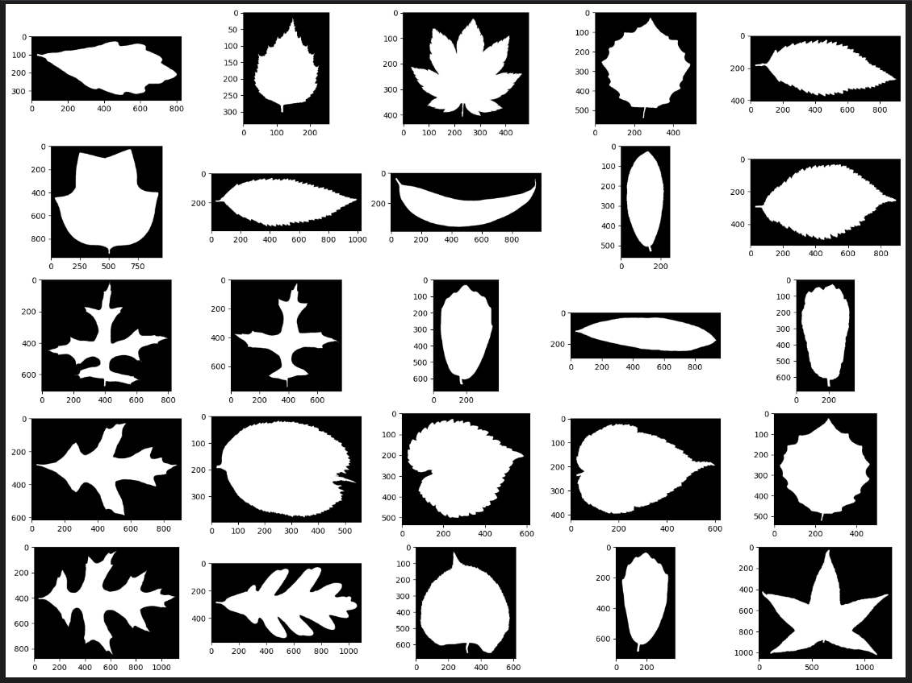
Results and Outputs
t-SNE (statistical method for visualizing high-dimensional data)
Leaf dataset

Slide 13
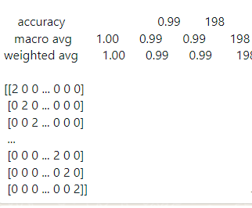
Results and Outputs

Slide 14
Conclusion
In this study, we have presented baseline automated identification techniques of plant species based on herbarium leaf images, using the pattern recognition approach.
Five machine learning algorithms: Random Forest, SGD, KNN, XGB, and SVM have been used to build identification models. Both models achieved satisfactory results demonstrating their usefulness in identification tasks. The study presented here showed that automated classification of plant species that had similar leaf shapes is feasible based on leaf images.
Although the SVM classifier has given us best results Though the developed system is not intended to replace human taxonomists, it may provide a rapid and easily accessible technique to identify plants with acceptable accuracy. We chose to work on species of plants as it is a large genus and species identification can be difficult especially to non-taxonomists

Slide 15
Future Scope
Working on bigger and more complex dataset which will contain a much wider array of species but will also require better hardware which can be achieved in the future.
We can use various parts of plants to identify the species of the plant.
We can make a real time image identification
We can also make a graphical user interface to make process more user friendly

Slide 16
References
Arora A., Gupta A., Bagmar N., Mishra S., Bhattacharya A.: A Plant Identification System using Shape and Morphological Features on Segmented Leaflets: Team IITK, CLEF 2012 In: CLEF (Online Working Notes/ Labs/Workshop). (2012)
Neeraj Kumar, Peter N. Belhumeur, Arijit Biswas, David W. Jacobs, W. John Kress, Ida C. Lopez, and João V. B. Soares, "Leafsnap: A Computer Vision System for Automatic Plant Species Identification", Computer Vision – ECCV 2012, 2012, pp 502-516.
Pavan Kumar Mishra, Sanjay Kumar Maurya, Ravindra Kumar Singh, Arun Kumar Misra, “A semi-automatic plant identification based on digital leaf and flower Images”, International Conference On Advances In Engineering, Science And Management (ICAESM), 2012, pp. 68-73.
ArunPriya C., Balasaravanan T., Antony Selvadoss Thanamani, “An Efficient Leaf Recognition Algorithm for Plant Classification Using Support Vector Machine”, Proceedings of the International Conference on Pattern Recognition, Informatics and Medical Engineering, 2012, pp. 428-432.
N.Valliammal, Dr. S.N.Geethalakshmi, “Automatic Recognition System Using Preferential Image Segmentation for Leaf and Flower Images”, Computer Science & Engineering: An International Journal (CSEIJ), 2011, pp. 13-25.

Slide 17
CONTRIBUTIONS
ANKIT – Acquired the dataset and pre-processed the dataset and the model.
LALIT – Worked on the model along with Ankit and Lohith.
LOHITH – Worked on the model along with Ankit and Lalit and fixed some bugs.

